Slide 1



Slide 2
Table of Content
What is Apache Spark
MapReduce vs Spark
Apache Spark Ecosystem
History of Apache Spark
Spark Pillars
Resilient Distributed Dataset (RDD)
Direct Acyclic Graph (DAG)
RDD Operations
Spark Cluster Architecture
Terminologies
SparkSQL

Slide 3
Prerequisite HDFS MR Hive Any one programming Language Scala Java Python and SQL

Slide 4

Apache Spark is a unified analytics engine for
large-scale data processing and machine learning

Slide 5

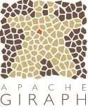












Evolution of Unified Analytics Engine
2004 -
2007 -
2014 -
Batch Processing
Faster Processing
Unified Platform
Batch Processing
Interactive, Machine Learning, Real time
Interactive Queries
Iterative, Streaming, Graph, SQL
Real-time Analytics
Machine Learning
Graph Processing

Slide 6
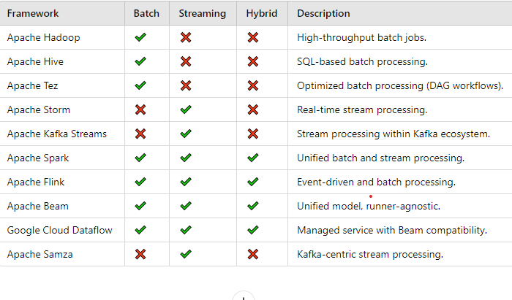

Slide 7
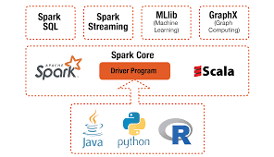
Spark Framework

Slide 8
Data Layer
Data pipeline
Data Storage
Data Processing
Data Testing
Data Visualization
Data Lake
Data Scheduler

Slide 9
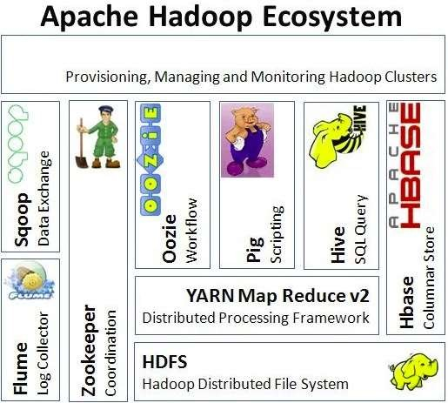

Slide 10
Apache Spark
Originally developed by Matei Zaharia in 2009 as a research project at University of Califirnia
Main Objective: to address the limitations of Hadoop MapReduce in terms of speed and ease of use
Flexibility – Scala, Python, Java, SQL and R
In-memory computation, Distributed and Parallel Processing
Batch and Streaming
Ease of use
Better Analytics – SQL queries, ML algorithms
Runs on Standalone Cluster, Apache Hadoop YARN, Apache Mesos, Kubernetes
Connects to hundreds of data sources
Spark Daemon process Master and worker

Slide 11
Spark Integration
Supports data storage like Hbase, other No SQL like Casandra, MongoDB
RDBMS using ODBC/JDBC
Hadoop HDFS
Amazon S3
Standalone file system NTFS,Ext etc.
Is spark is replacement of Hadoop?
Spark (refer framework) can use all the components of Hadoop (spark got launched in the period of 1 /2 yrs with 10x speed)
Its an replacement of MR

Slide 12
Apache Spark
Deployment Modes
Standalone – maybe10 Linux systems are installed only with spark
YARN – Hadoop installed with Spark
Mesos – Less used cluster manager supports spark to run
REPL– Read Evaluate Print Loop Also called Spark CLI (spark shell can be used to test the coding)
Two shells are available
Spark shell – scala code
Pyspark –Python code

Slide 13
Spark API
Three Important API (Heart of Spark)
RDD
Data Frames
Data Set
Transformations and Actions

Slide 14

MapReduce vs Spark
Factors | Apache Spark | MapReduce
Speed | 10 – 100 times faster | Faster than traditional systems
Written using | Scala (69.9%), Python (14%), Java (8.8%), SQL (3%), R (2.4%) | Java
Data Processing | Batch / Iterative / Interactive / Real-time / Graph | Batch
Complexity | Compact and Simple to use | Complex and Lengthy
Cache | In-memory/Disk Caching | More Disk IO and Minimal Caching

Slide 15




Beyond MapReduce
MapReduce - Batch Processing
MapReduce - No support for Real-time, Interactive, In-memory, Machine Learning and Graph data
Spark - To handle all workloads. It offers
In-memory data caching - scan HDD only once, then all IO operations performed in RAM
Efficient Pipeline
Lazy Evaluation - Execution will not start until an action is triggered

Slide 16
Apache Spark Ecosystem

Slide 17
Apache Spark Ecosystem
Spark SQL
+
DataFrames
Batch
+
Streaming
ML Lib
+
Machine Learning
GraphX
Spark Core API
Scala
Python
SQL
Java
R

Slide 18
Apache Spark History
Information
Started as a Research project at UC Berkeley
Donated to Apache Software Foundation (ASF) & Databricks Founded
DataFrame and Dataset APIs introduced
Apache Spark 3.0
2010
2014
2016
2009
2013
2015
2020
Open Sourced and First Research Paper Published
Spark 1.0
(Spark Core, Spark SQL, ML lib)
Release of Spark 2.0

Slide 19
Spark - Pillars
Resilient Distributed Dataset (RDD)
Direct Acyclic Graph (DAG)

Slide 20
Resilient Distributed Dataset (RDD)
Resilient – Data can be recreated when the data in memory is lost (Fault Tolerant)
Distributed – The memory is shared across the worker nodes of the cluster.
Dataset – The file created programmatically.
In spark, RDDs are fundamental unit of data
Fundamental abstraction used for representing distributed data across a spark cluster

Slide 21
RDD
Object
Immutable
Distributed
Cached
Partitioned
Rebuilt lost data (partition) on failure
Parallel processing

Slide 22
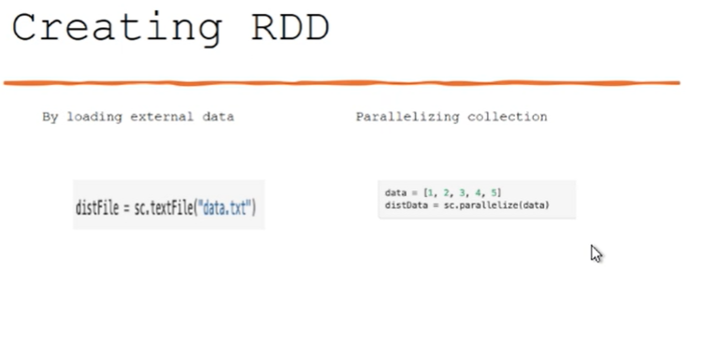
When you create an RDD, it is divided into partitions, · Spark distributes these partitions across the cluster nodes based on:
Cluster resources: The number of cores and memory available on each node.
Partitioning strategy: Defined when creating the RDD or dataset.

Slide 23
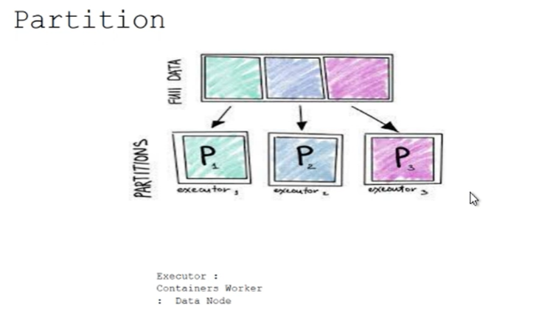
Partitions:
Determined by the dataset and transformations.
Configurable using APIs like .repartition() or .coalesce().

Slide 24
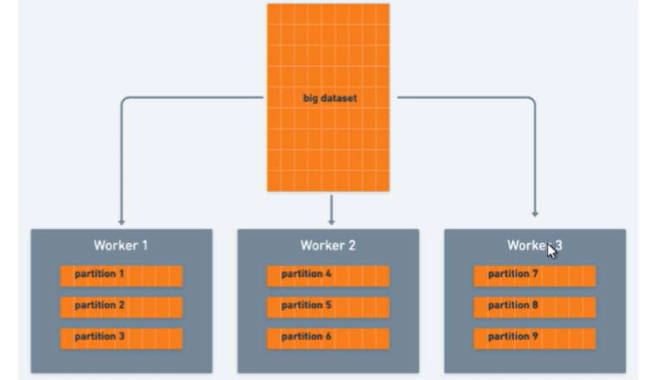

Slide 25
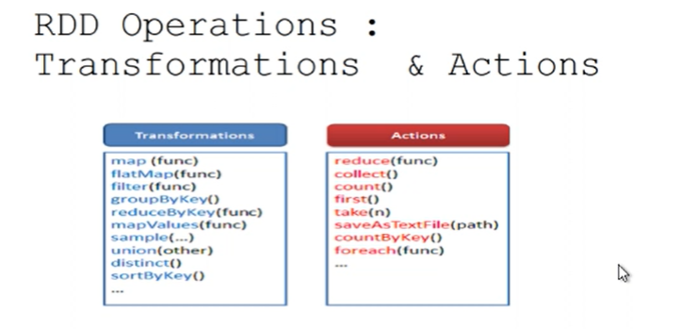

Slide 26
Execution sequence
The main driver program Initializes sparkContext object.
SparkContext connects cluster Managers (In order to execute spark applications as independent sets of process on a cluster).
Cluster Managers allocate resources across applications
Spark application acquires executors on nodes in the cluster
sparkContext sends application code to executors
SparkContext sends tasks to the executors to run.

Slide 27
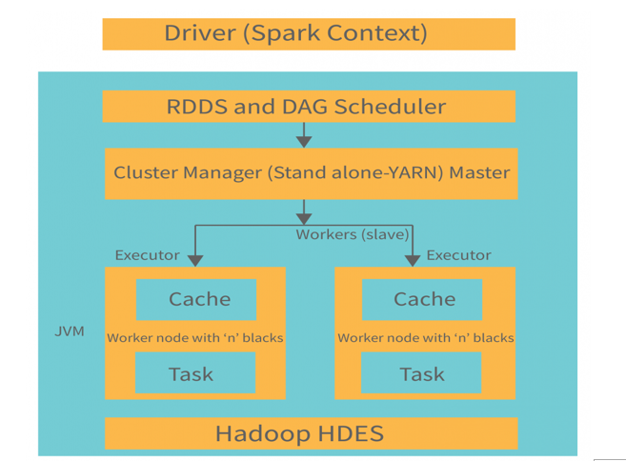

Slide 28
Architecture components
Drive program/process
Runs main Function
Manage/Maintain information about spark application
Respond to user program/Input
Analyze/schedule distribute work across executor
Executor process
Perform task/code that driver assigns them.
Reports execution state back to driver
Cluster Manager
Keeps track of available resources

Slide 29
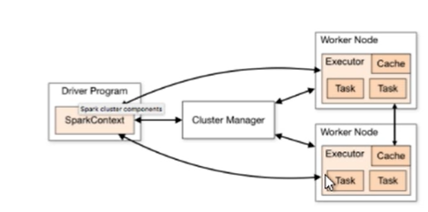
Spark cluster execution

Slide 30
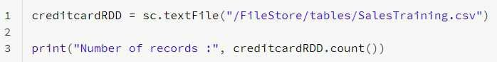
Resilient Distributed Dataset (RDD)
Data read from a file will form a single RDD
RDDs are divided into logical partitions, which are stored on different worker machines of the cluster
RDD is an immutable, distributed across nodes
Fault tolerant – using DAG (Lineage)
Partitions can be persisted in-memory or disk
Lazily Evaluated and Executed

Slide 31

Resilient Distributed Dataset (RDD)
Resilient (Fault Tolerant) – when the data in memory is lost, it can be recreated
Distributed - stored in memory across the worker nodes of the cluster
Dataset - file/created programmatically
RDDs are the fundamental unit of data in Spark
pointer to parent
transformations (map, filter..)
RDD
(Immutable)
New RDD
(Immutable)
actions (collect, count..)
Driver Node

Slide 32


Direct Acyclic Graph (DAG)
Sequence of computations performed on data
Node - Where RDD partitions resides
Edge - Transformation of top of data
Acyclic - Can’t return to the old partition
Direct - Transformation is an action that transitions data partition state (from A to B)
RDD 1
Transformation
RDD 2
Lineage - Shows dependency between RDDs
RDD 4
RDD 3
Stage
RDD 5
Action

Slide 33
Spark Program Lifecycle
Spark Session
Data
RDDs
Transformations
Actions

Slide 34
RDD Operations - Transformations
Transformations create a new RDD from an existing RDD
RDDs are immutable
Data in an RDD can’t be changed
Transformations are performed in sequence to modify the data as needed
Common Transformations
map() - creates a new RDD by performing a function on each record of the parent RDD
filter() - applies a boolean function on each record of the parent RDD to include/exclude records and creates a resultant RDD
Types
Narrow Transformations
Wide Transformations
transformations (map, filter)
Old RDD
New RDD
Source data
(Immutable)
(Immutable)

Slide 35
Transformations
Narrow Transformation (filter)
Wide Transformation (reduceByKey)
CAT DOG MAN
CAT DOG MAN
CAT
CAT
CAT DOG MAN
CAT DOG MAN
CAT
DOG
CAT DOG CAT
CAT DOG CAT
CAT
MAN
CAT DOG MAN
CAT DOG MAN
CAT

Slide 36
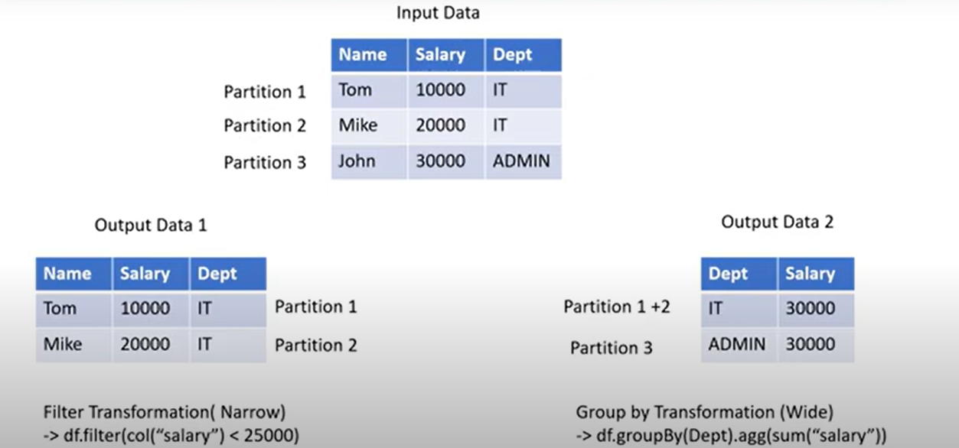
Narrow Vs Wide Transformations

Slide 37
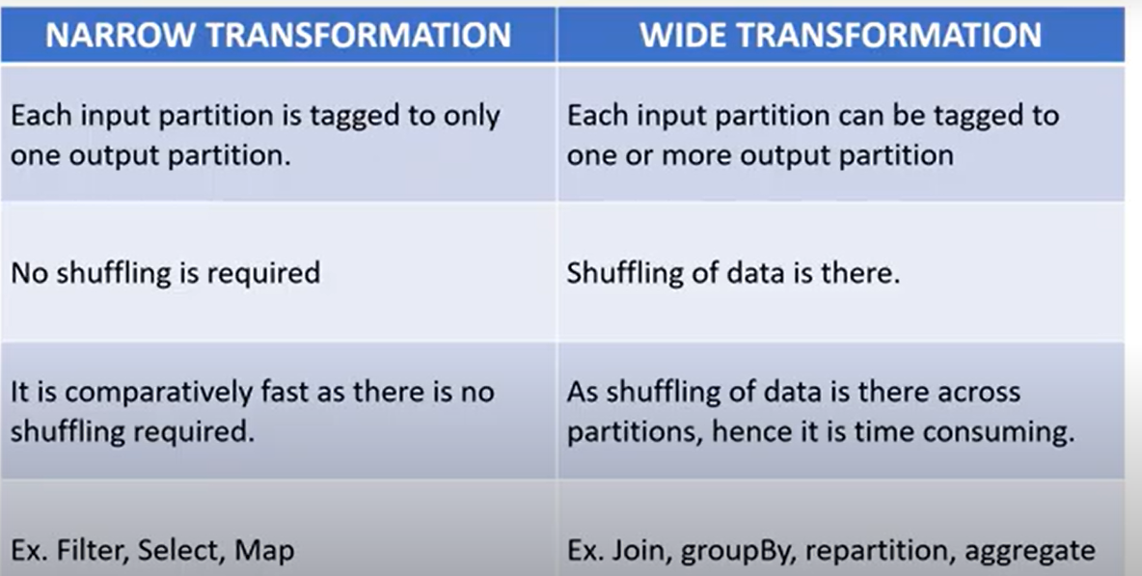

Slide 38
Transformations
The following table lists some of the common transformations supported by Spark
Transformation | Meaning
map(func) | Return a new distributed dataset formed by passing each element of the source through a function func
filter(func) | Return a new dataset formed by selecting those elements of the source on which func returns true
flatMap(func) | Similar to map, but each input item can be mapped to 0 or more output items (so func should return a Seq rather than a single item)
coalesce(numPartitions) | Decrease the number of partitions in the RDD to numPartitions. Useful for running operations more efficiently after filtering down a large dataset

Slide 39
Transformations
Transformation | Meaning
mapPartitions(func) | Similar to map, but runs separately on each partition (block) of the RDD, so func must be of type Iterator<T> => Iterator<U> when running on an RDD of type T
mapPartitionsWithIndex(func) | Similar to mapPartitions, but also provides func with an integer value representing the index of the partition, so func must be of type (Int, Iterator<T>) => Iterator<U> when running on an RDD of type T
groupByKey([numTasks]) | When called on a dataset of (K, V) pairs, returns a dataset of (K, Iterable<V>) pairs
reduceByKey(func, [numTasks]) | When called on a dataset of (K, V) pairs, returns a dataset of (K, V) pairs where the values for each key are aggregated using the given reduce function func, which must be of type (V,V) => V. Like in groupByKey, the number of reduce tasks is configurable through an optional second argument

Slide 40
Transformations
Transformation | Meaning
repartition(numPartitions) | Reshuffle the data in the RDD randomly to create either more or fewer partitions and balance it across them. This always shuffles all data over the network
aggregateByKey(zeroValue)(seq Op, combOp, [numTasks]) | When called on a dataset of (K, V) pairs, returns a dataset of (K, U) pairs where the values for each key are aggregated using the given combine functions and a neutral "zero" value
sortByKey([ascending], [numTasks]) | When called on a dataset of (K, V) pairs where K implements Ordered, returns a dataset of (K, V) pairs sorted by keys in ascending or descending order, as specified in the boolean ascending argument
distinct([numTasks])) | Return a new dataset that contains the distinct elements of the source dataset

Slide 41
RDD Operations - Actions
Actions return a value to the Driver program after running a computation on the dataset
Some common actions are
count() - returns the number of elements
take(n) - returns an array to the Driver program having first ‘n’ elements
collect() - returns an array of all the elements
saveAsTextFile(filename) - save the elements to text file
transformations (map, filter)
Old RDD
New RDD
Source data
(Immutable)
(Immutable)
Driver Node
actions (count, collect)

Slide 42
Actions
The following table lists some of the common actions supported by Spark
Actions | Meaning
reduce(func) | Aggregate the elements of the dataset using a function func (which takes two arguments and returns one). The function should be commutative and associative so that it can be computed correctly in parallel
collect() | Return all the elements of the dataset as an array at the driver program. This is usually useful after a filter or other operation that returns a sufficiently small subset of the data
count() | Return the number of elements in the dataset
first() | Return the first element of the dataset (similar to take(1))
take(n) | Return an array with the first n elements of the dataset

Slide 43
Actions
Actions | Meaning
takeSample(withReplacement, num, [seed]) | When called on a dataset of (K, V) pairs, returns a dataset of (K, Iterable<V>) pairs
takeOrdered(n, [ordering]) | Return the first n elements of the RDD using either their natural order or a custom comparator
saveAsTextFile(path) | Write the elements of the dataset as a text file (or set of text files) in a given directory in the local filesystem, HDFS or any other Hadoop-supported file system. Spark will call toString on each element to convert it to a line of text in the file
saveAsSequenceFile(path) (Java and Scala) | Write the elements of the dataset as a Hadoop SequenceFile in a given path in the local filesystem, HDFS or any other Hadoop-supported file system. This is available on RDDs of key-value pairs that implement Hadoop's Writable interface

Slide 44
Actions
Actions | Meaning
saveAsObjectFile(path) (Java and Scala) | Write the elements of the dataset in a simple format using Java serialization, which can then be loaded usingSparkContext.objectFile()
countByKey() | Only available on RDDs of type (K, V). Returns a hashmap of (K, Int) pairs with the count of each key

Slide 45
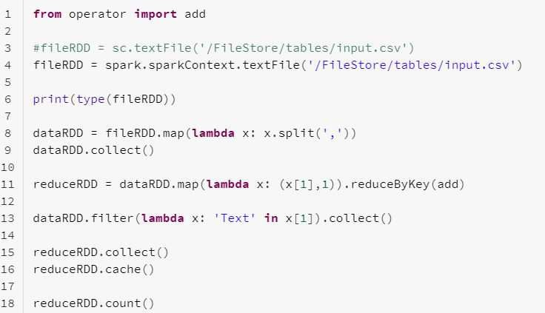
A Sample Spark Application
Import library
RDDs
Transformation
Transformation
Transformation & Action
In-memory
Action

Slide 46
RDD Lineage
When a transformation is called, Spark does not execute it immediately (lazy evaluation), instead it creates a lineage
Lineages in the form of DAG, used by the Driver program to perform sequence of computations on data
fileRDD = spark.sparkContext.textFile('/FileS tore/tables/input.csv')
dataRDD.collect()
lineage
transformation (map)
fileRDD
dataRDD
Source data
(Immutable) (Immutable)
Driver Node
actions (count)
dataRDD = fileRDD.map(lambda x: x.split(','))

Slide 47
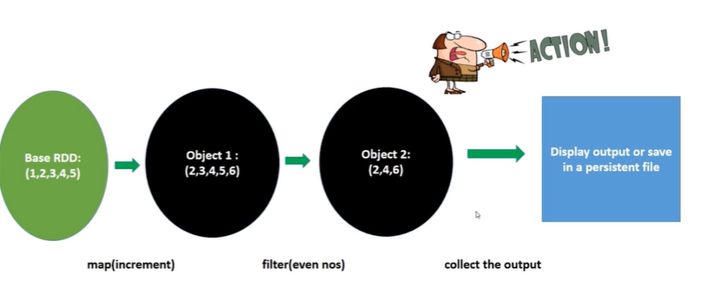
Lazy Application

Slide 48
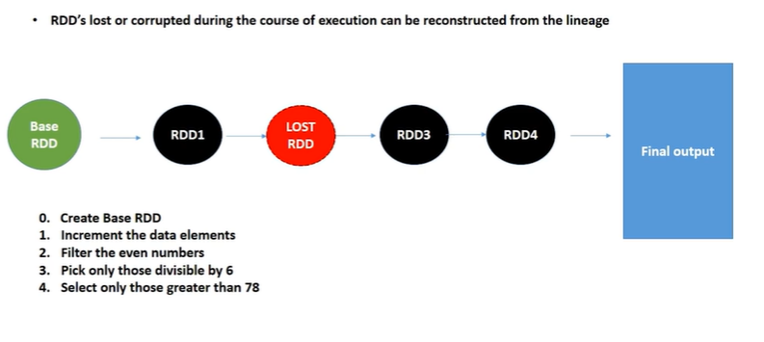
RDD fault tolerant (resilient)

Slide 49
Apache Spark Architecture
Master-Slave Architecture
One central coordinator called Spark Driver, which communicates with Workers
Each Worker Node consists one or more Executor(s) responsible for executing the tasks (Transformations, Actions) assigned by the Driver program
Working combination of Driver and Executors makes the Spark application
The Spark application relies on Cluster Manager for allocating Worker Nodes. The Cluster Manager can be:
Apache Yarn
Standalone Spark Cluster
Apache Mesos
Kubernetes

Slide 50
Apache Spark Architecture - Driver Program
The Driver program creates SparkSession object, which allocates and coordinates tasks of the Spark application
Converts the code to tasks and determines number of tasks
Helps creating DAG, lineage, logical and physical plans
Connects with Cluster Manager, which allocates resources (in Worker node) for the Spark application
Acquires Executors in Worker Nodes
Sends the Application code and tasks to the Executors to run
Works with Executors for completing the Spark application

Slide 51
Apache Spark Architecture - Executors
Executors resides in the Worker node
Each Executor has its own computation resources for executing the tasks
Worker node can have one or more Executors
Responsible for executing the tasks assigned by the Driver program
Distributed Parallel Processing - Each Executor runs the code individually and parallelly
Sends the output to the Driver program
Caches the data in-memory, which enables faster processing
Upon completion of the Spark application, all the assigned Executors are released

Slide 52





Spark Application - Life Cycle
2
Spark submit launches Driver
4
Drivers connects with CM for resources
Worker Node
Executor
Task Task
Memory
Driver Program
6
SparkSession Datasets Transformations Actions
Cluster Manager
Executors run the tasks
Worker Node
Executor
Task Task
Memory
User submits Spark application
Driver creates SparkSession
CM launches Executors for Driver
5
1
3
When Driver main() exits, all the resources are releases 7

Slide 53
Terminologies
Information
Driver Program
Java Virtual Machine (JVM) allocated to start the execution of main()
Creates SparkSession
SparkSession
Tells how to access the cluster components
Cluster Manager
Service to manage and allocate the resources on the cluster
Deploy Mode
cluster - Driver program runs in one of the cluster Worker nodes
client - Driver runs outside of cluster

Slide 54
Terminologies
Information
Worker Node
A place, where Executor resides
Executor
JVM launched by the Worker node to execute the tasks from Driver
Will have computation resources
Keeps data in memory or disk when reading from external resources
Job
Collection of Stages
Stage
Each Job can have one or more Stages
Stages are executed sequentially
Each Stage has tasks
Task
Unit of work, which is sent to the Executor
Partition
Data unit what will be handled parallelly

Slide 55

Databricks

Slide 56
Table of Content
What is Databricks?
Databricks History
Working with Databricks Community Edition
Spin up a Cluster
Create a new Notebook
Writing Spark Programs
Uploading files to DBFS
How Spark Works in the Background?
Class Exercise

Slide 57
Databricks
Databricks is headquartered in San Francisco, California and was founded by the creators of open source projects, including Apache Spark, Delta Lake, MLflow and Koalas
Cloud based Data Analytics platform for processing and transforming large quantities of data
Apache-Spark based platform
Runs a distributed system behind the scenes to enable distributed parallel processing for handling massive workloads
Available in AWS, Azure and GCP
Supports commonly used programming languages like Scala, Python, R, and SQL
Integrates easily with other Cloud services
Supports various file formats, connects with hundred of data sources
Growing community, extensive documentation and support
Thousands of global customers

Slide 58
Databricks History
Databricks founded by the creators Apache Spark
Microsoft announce Azure Databricks (preview)
Databricks launched in AWS cloud
Databricks made available in GCP
2014
2016
2018
2013
2015
2017
2020
Databricks beta launched AWS cloud
Databricks Community Edition made available
Azure Databricks launched for public

Slide 59
Databricks
Community Edition

Slide 60
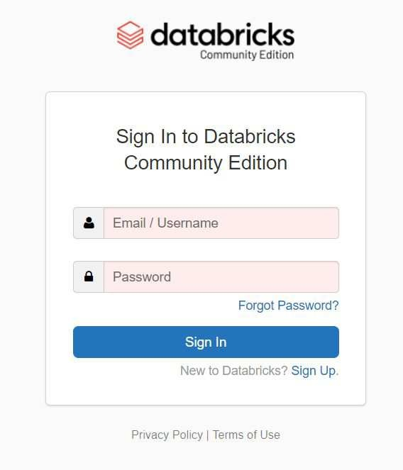
Databricks - Sign Up
1
Click “Sign In”

Slide 61
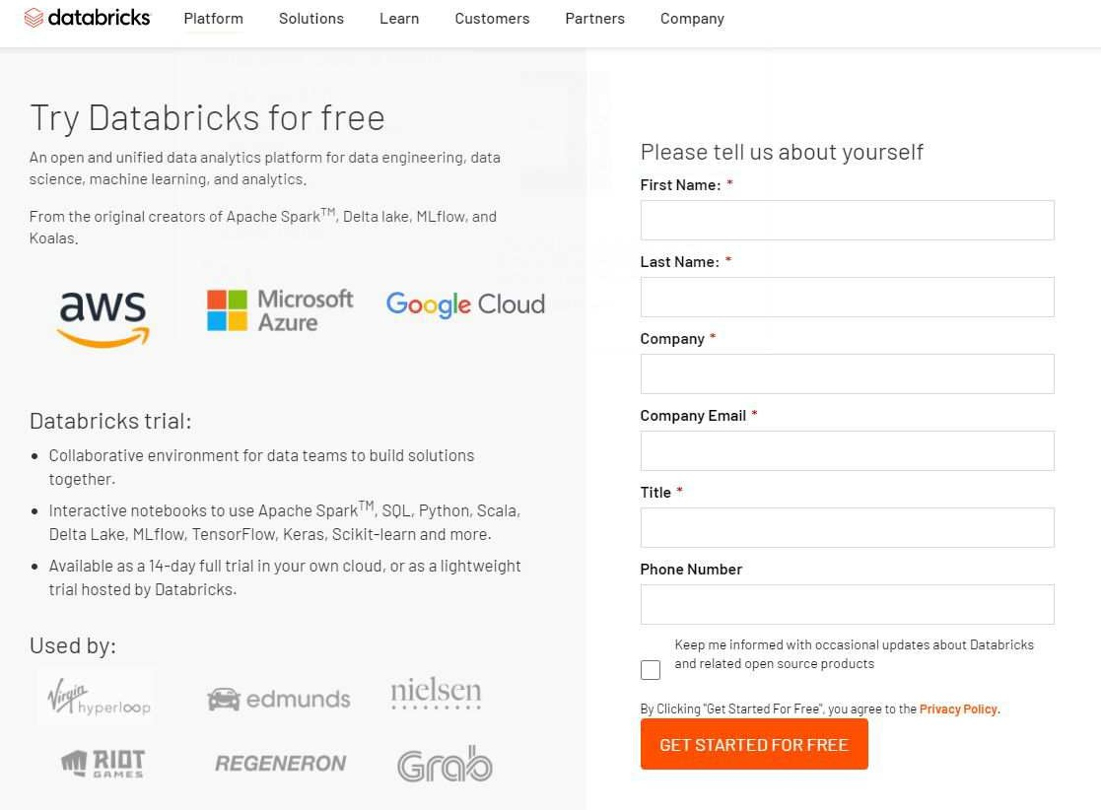
Databricks - Sign Up
2
Fill all the boxes and select
“GET STARTED FREE”

Slide 62
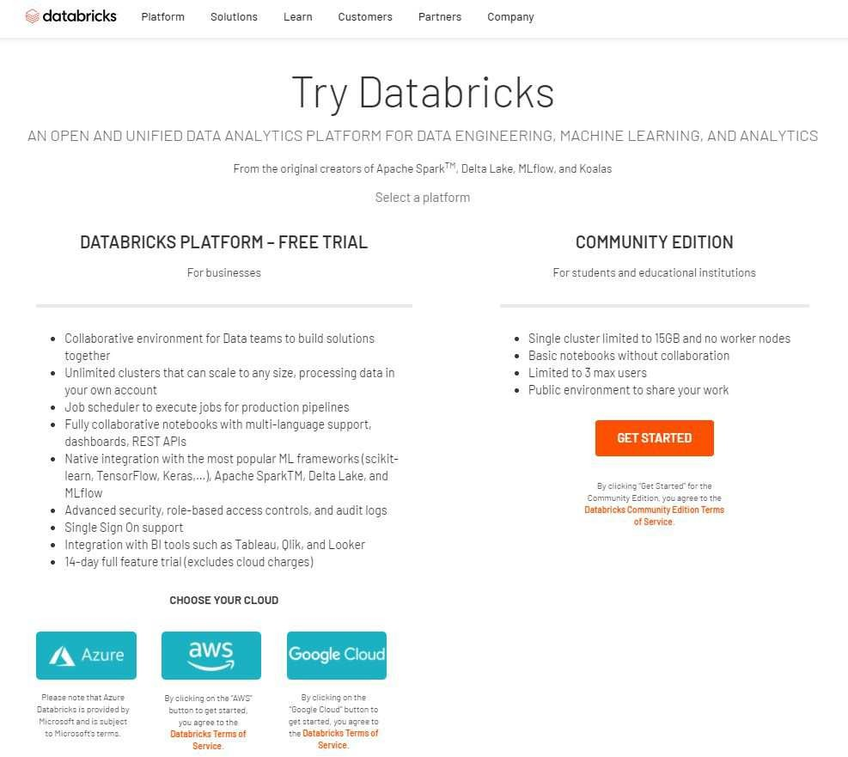
Databricks - Sign Up
3
Click “GET STARTED”

Slide 63
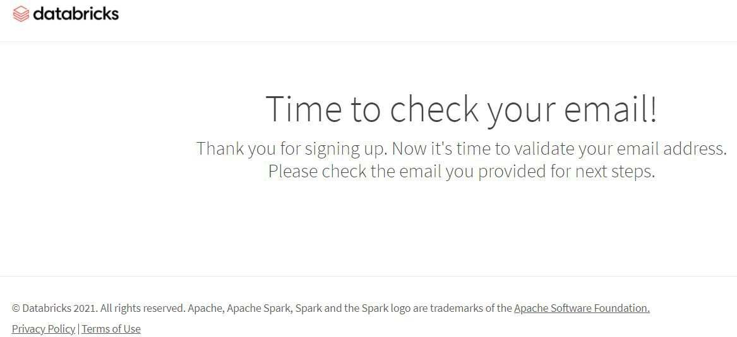
Databricks - Sign Up
4

Slide 64
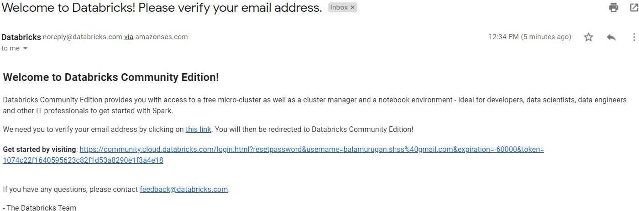
Databricks - Sign Up
5
Click the link

Slide 65
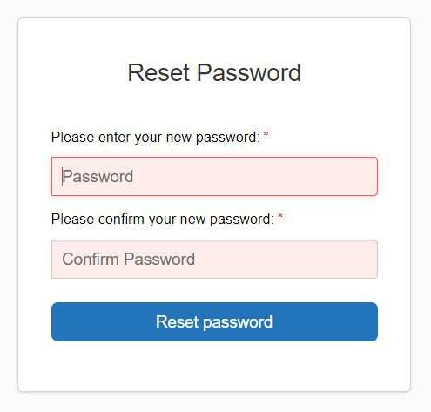
Databricks - Sign Up
6
Enter the “Password”
Confirm the “Password”
Click “Reset Password”

Slide 66
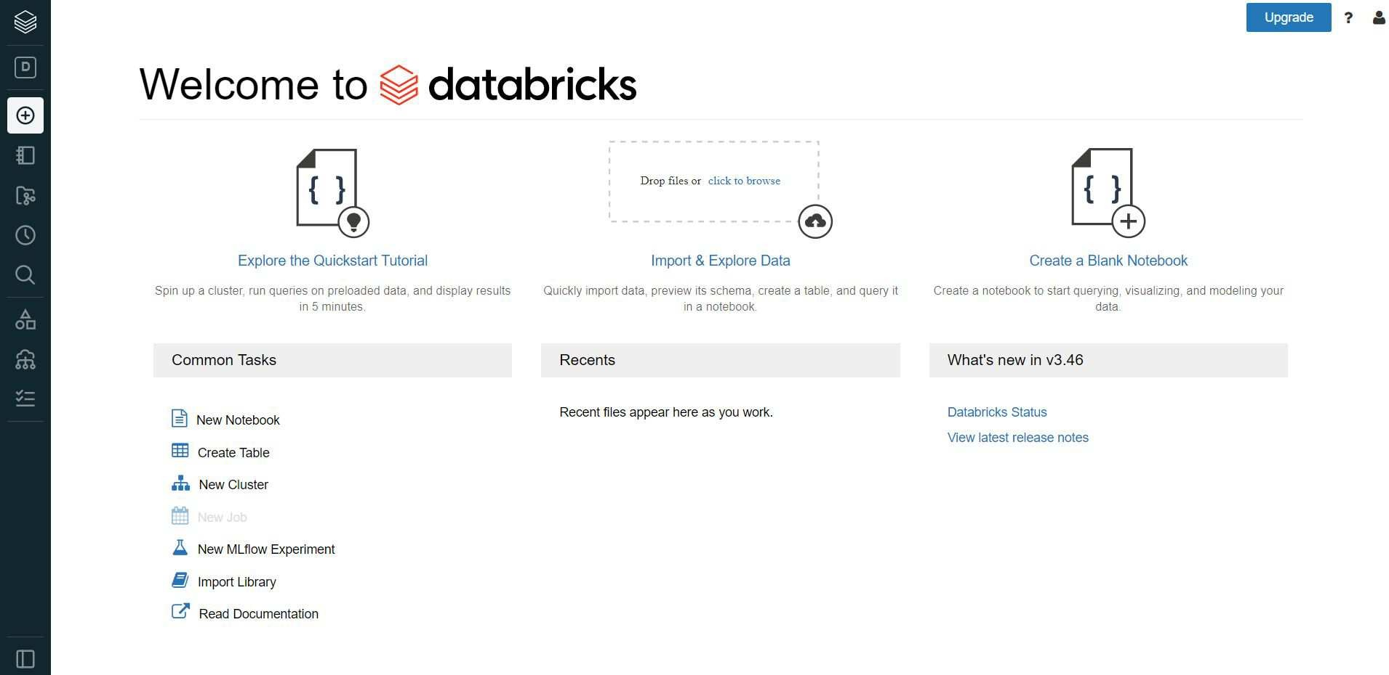
Welcome to Databricks

Slide 67
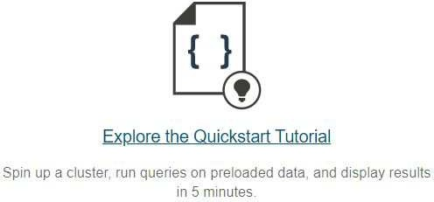
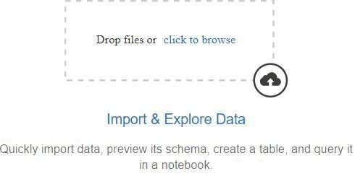
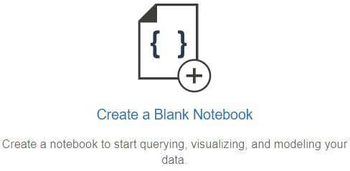
Working in Databricks
Spin up a cluster
Load the data
Create a notebook
★ Community Edition helps us to create a single node cluster. Both Driver and Executors will use the same node
★ Databricks support various file formats like csv, json, xml, text. It can also connect to various data sources
★ Databricks provide Jupyter
Notebooks to write coding in Spark SQL, Python, Scala, R and Java

Slide 68
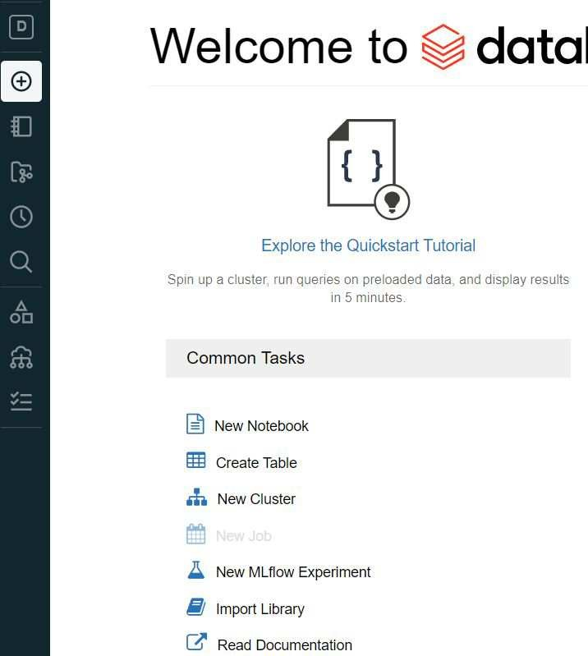
Spin up a cluster
1
Create “New Cluster”

Slide 69
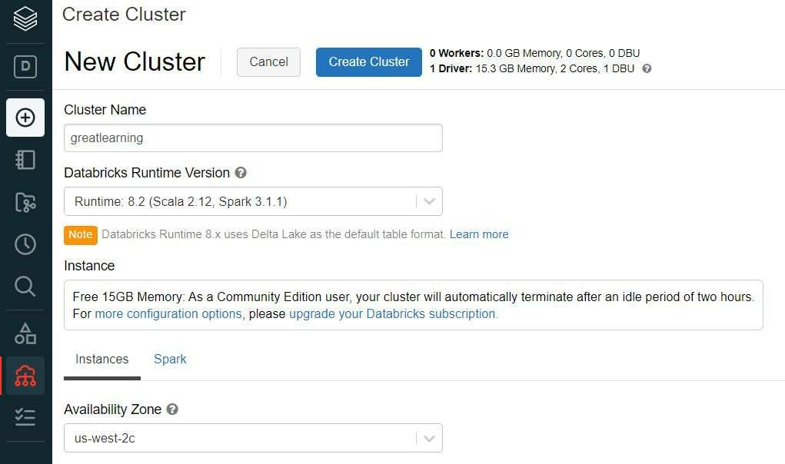
Spin up a cluster
2
Enter the cluster name
Choose the Databricks Runtime Version
Choose Availability Zone
Click “Create Cluster”
It creates a single node cluster with 15.3 GB memory, 2 cores
It takes a few minutes to create the cluster

Slide 70
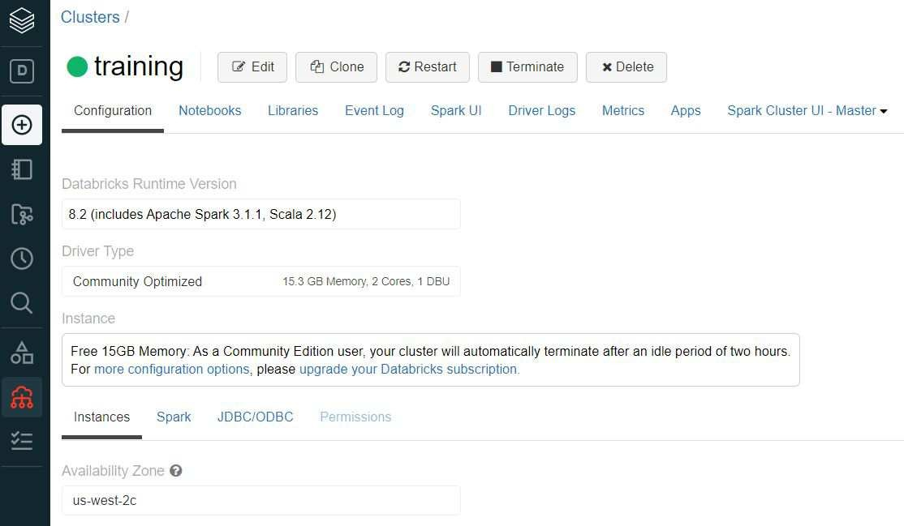
Spin up a cluster
3
Cluster is ready

Slide 71
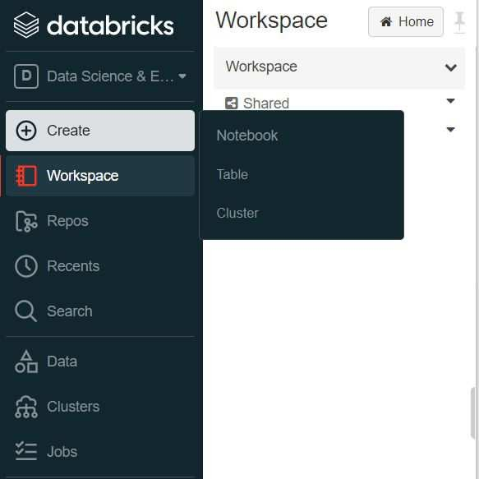
Create Notebook
1
Create
Click “Notebook”

Slide 72
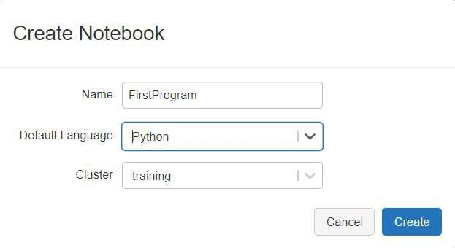
Create Notebook
2
Enter the Notebook name
Choose the language. Databricks CE support Python, Scala, R and SQL
Choose the Cluster. In CE, you can have only one cluster
Click “Create”

Slide 73
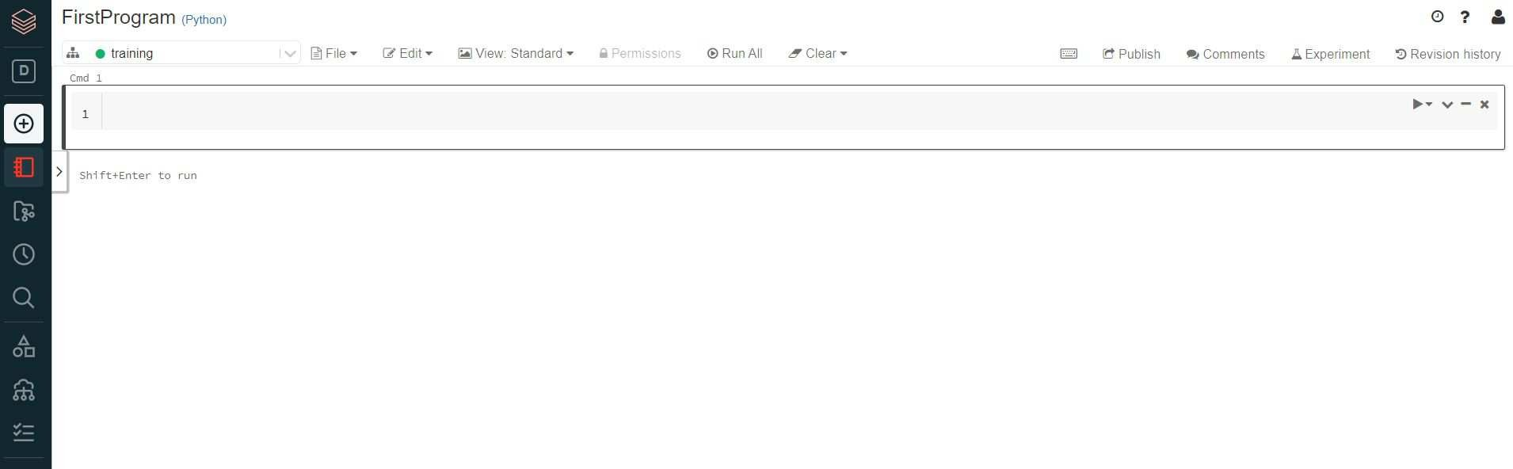
Create Notebook
3
Write you code here

Slide 74
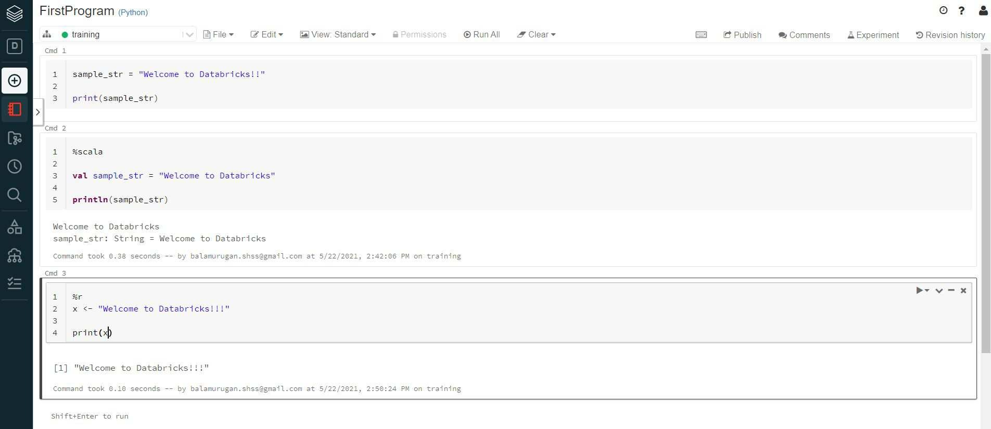
Write your first program
Control + Enter => will execute a single cell
Shift + Enter => will execute a single cell + creates a new blank cell
“Run All” will execute all the cells (highlighted in blue)
“Run” will execute a single cell
%python - python, %scala - scala, %sql - Spark SQL, %r - R

Slide 75
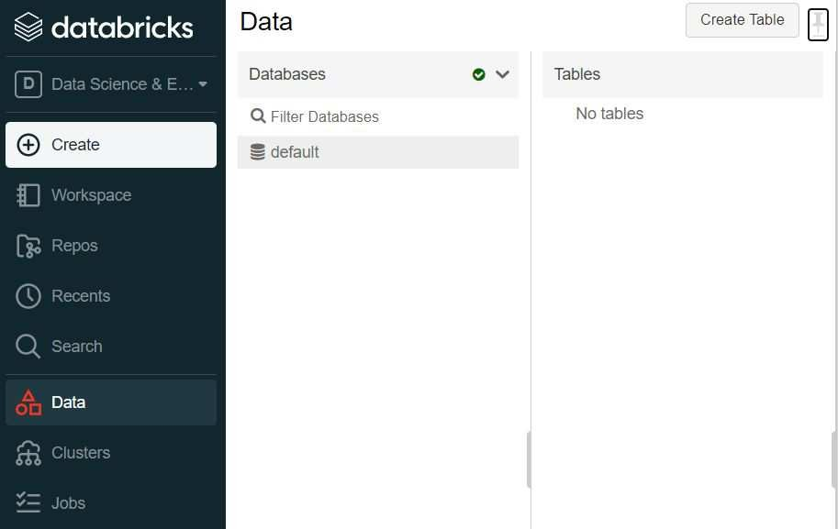
Loading file(s) to DBFS
2
Loading files to Databricks File System (DBFS)
Click “Data” tab
Click “Create Table”
1

Slide 76
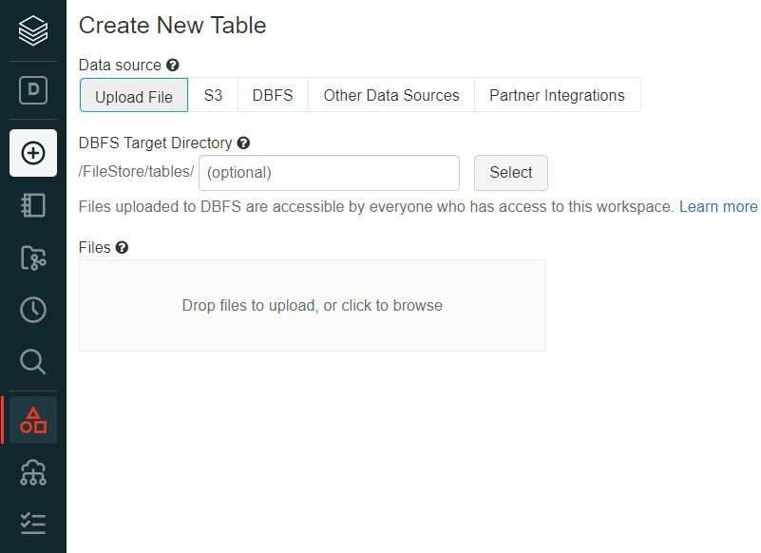
Loading file(s) to DBFS
Upload your files

Slide 77
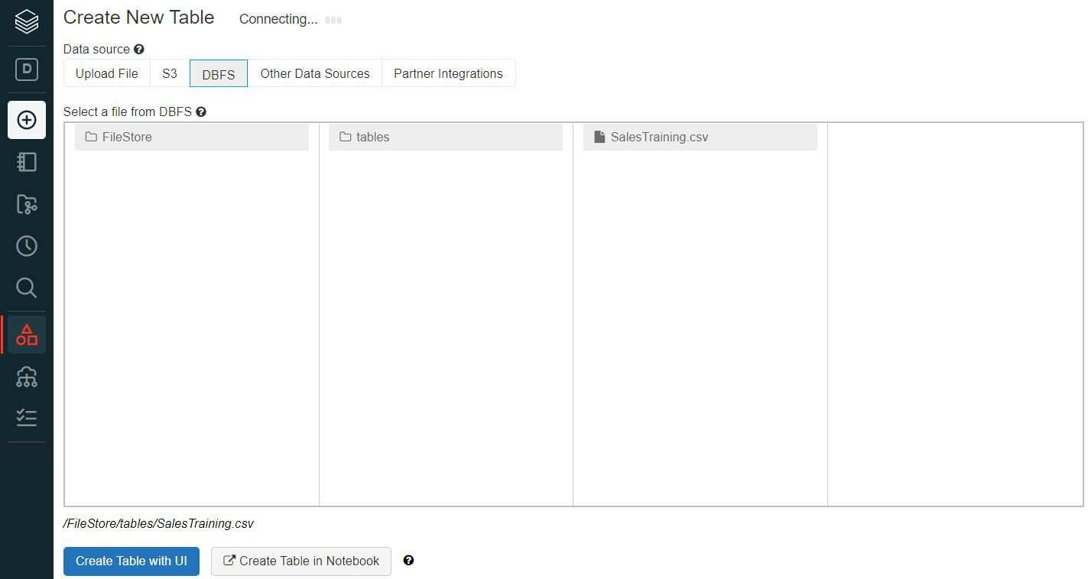
Loading file(s) to DBFS
File Loaded Successfully
Note : File loaded to “/FileStore/tables/SalesTraining.csv” (DBFS)

Slide 78
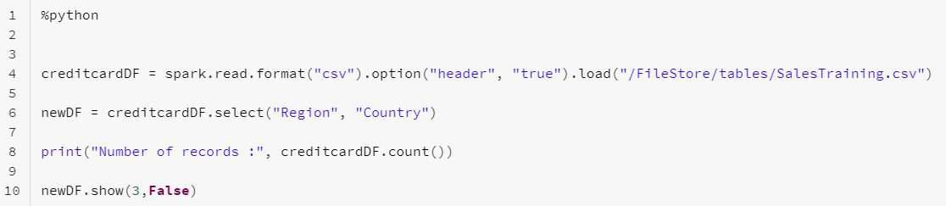

Working in Databricks
lineage
creditcardDF = spark.read.format(“csv”)
.load(“/FileStore/tables/input.csv”)
newDF = creditcardDF(“Region”, “Country”)
newDF.show(3, False)
Source data
creditcardDF
(Immutable)
newDF
(Immutable)
Transformation
Action
Driver Node

Slide 79

What happens in the background?
Source Data
Executor Cores - 4
Executor Memory - 20GB Partitions
DataFrame
Task
Task
e.g. spark.read.format(“csv”)
Executor

Slide 80

Class Exercise
Class Exercise
Create a CSV file with customer information (custID, custName, city, state, custType, balance) having a few records. Example:
Load the file in to DBFS (“/FileStore/tables/customer.csv”)
Create the RDD by reading the file using sparkContext.textFile method
Apply transformations like map, filter to create a new RDD having records with balance > 1000. Don’t include the header record in the new RD

Slide 81
Spark DataFrames

Slide 82
Table of Content
What is DataFrame in Spark?
Creating DataFrames
From RDDs
From various sources / datasets
DataFrameReader
Working with a CSV file
Defining your own Schema
Selecting DataFrame columns
Renaming columns
Adding and Dropping DataFrame columns
selectExpr
Handling null Values
DataFrame Aggregations
Coalesce vs Repartition
Cache vs persist
DataFrameWriter

Slide 83
Spark DataFrames
Immutable, distributed collection of data that is organized into rows and columns
Each column has a name and associated type
Similar to a table in RDBMS
Like RDD APIs, the DataFrame APIs are classified into 2 buckets : transformations, actions
Transformations are lazily evaluated, and actions are eagerly evaluated
DataFrame APIs are available in Scala, Python, Java and R
DataFrames can be created from existing RDDs, and data sources
Spark supports 6 built-in data formats - csv, parquet, json, jdbc, text and orc

Slide 84
Creating DataFrames
Creating DataFrames from RDDs
Creating DataFrame from Data Sources/External Datasets

Slide 85
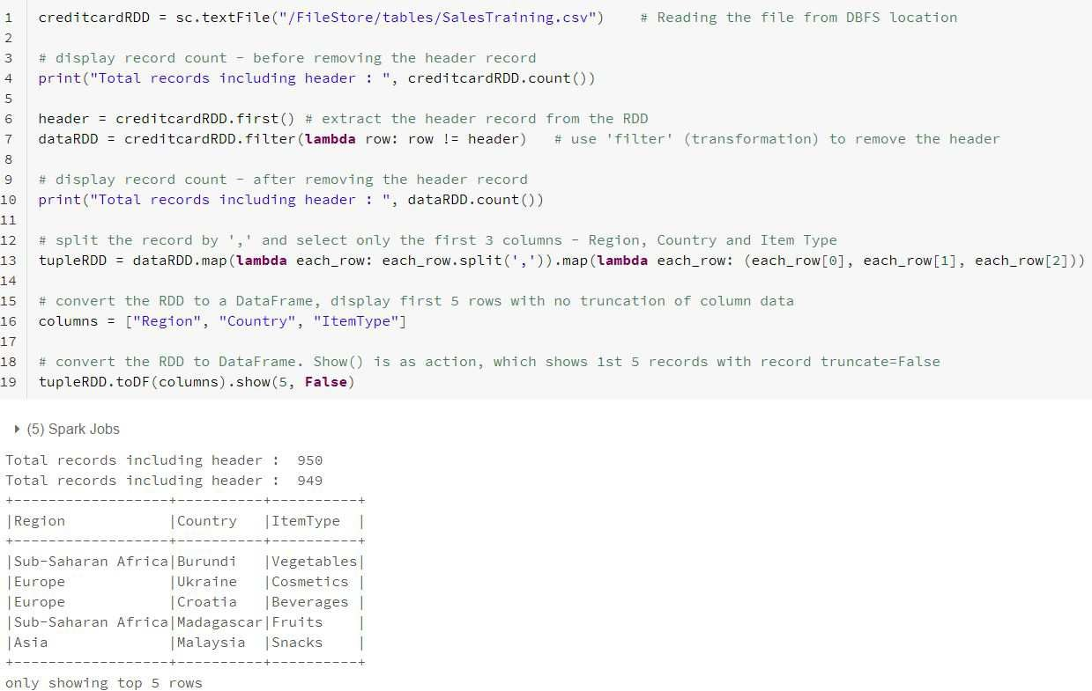
Creating DataFrames from RDDs

Slide 86
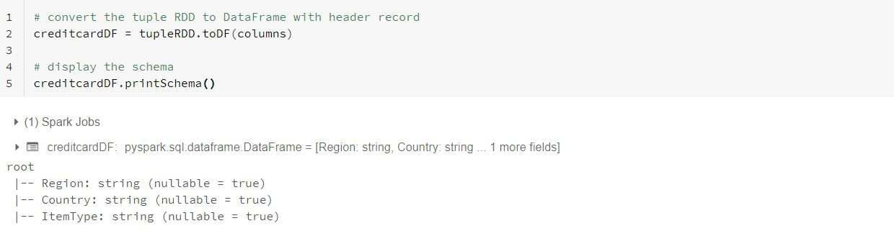
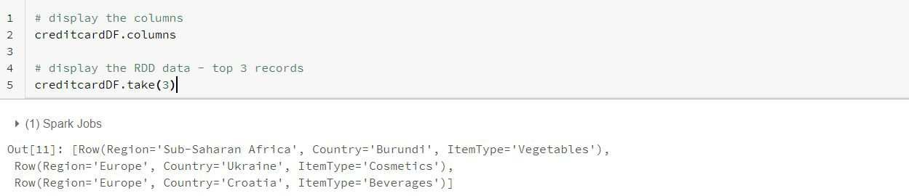
DataFrame Schema and Columns

Slide 87
Creating DataFrames from Data Sources
DataFrames can directly be created from various data sources or external datasets
Spark supports 6 built-in data sources, where each data source is mapped to a data format
Common formats for text data are CSV, XML and JSON
Common formats for binary data are Avro, Parquet, and ORC
The two main classes in Spark for reading and writing data are DataFrameReader and DataFrameWriter
DataFrameReader and DataFrameWriter are available with SparkSession

Slide 88
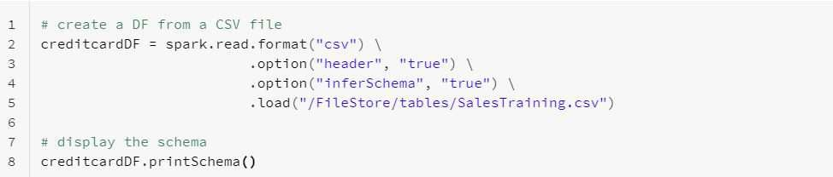
DataFrameReader
spark.read.format(...).option("key", value").schema(...).load()
format - json, parquet, jdbc, orc, csv, text
option - DataFrameReader has a set of default options for each data source format, which can be overridden
schema - Some data sources have the schema embedded inside the data files, i.e., Parquet and ORC. For other formats, provide a schema

Slide 89
Working with CSV files
1
One of the commonly used file formats
Databricks can connect and read data from number of sources like Cloud Storage Services, Databricks File System, HADOOP
Read the data using the DataFrameReader by passing all the necessary details
Apply DataFrame APIs to transform the data, push the data on to respective sources by executing the actions

Slide 90
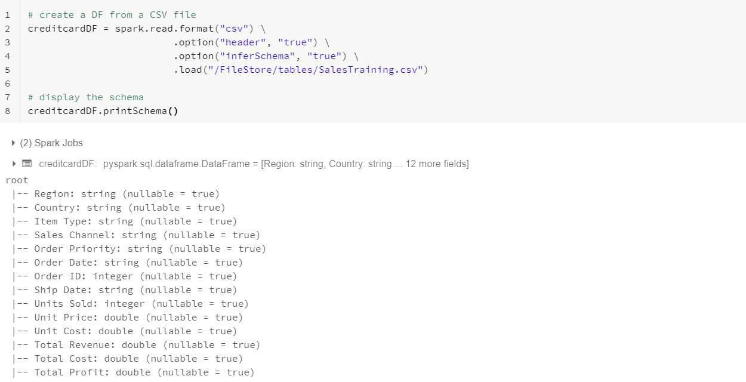
Working with CSV files
2
spark.read.format(..) returns the DataFrame object
Option “inferSchema” infers the schema for each column
Option “header” treats the first record as header record

Slide 91
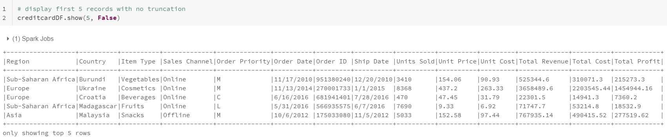
Working with CSV files
3
df.show(..) is an action, which brings the transformed data to the Driver node
Spark executes all transformations present in the Lineage (DAG), when an action is triggered

Slide 92
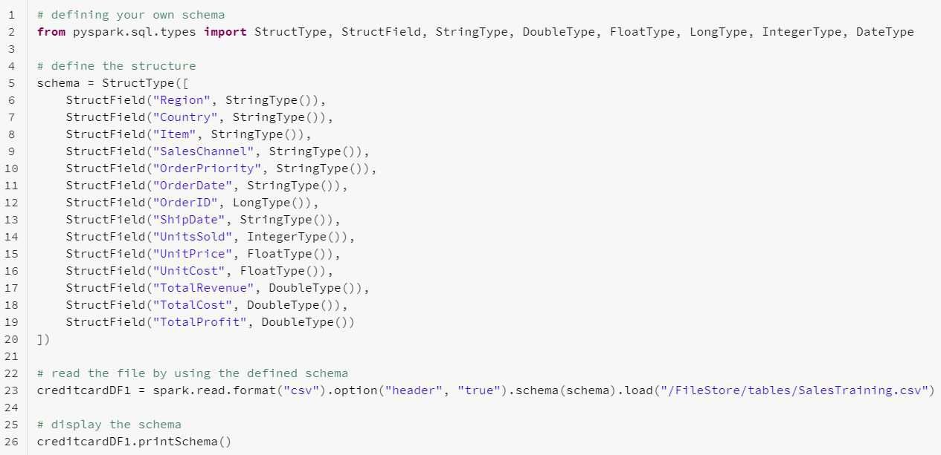
Defining Own Schema
1

Slide 93
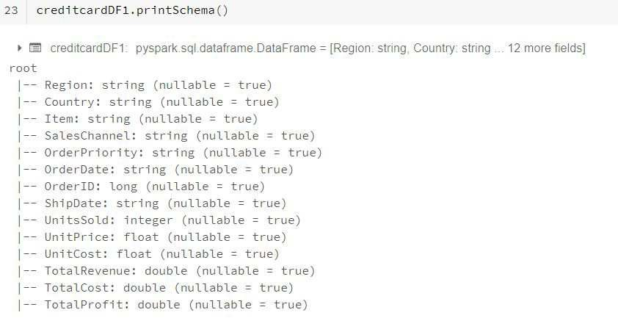
Defining Own Schema
2

Slide 94
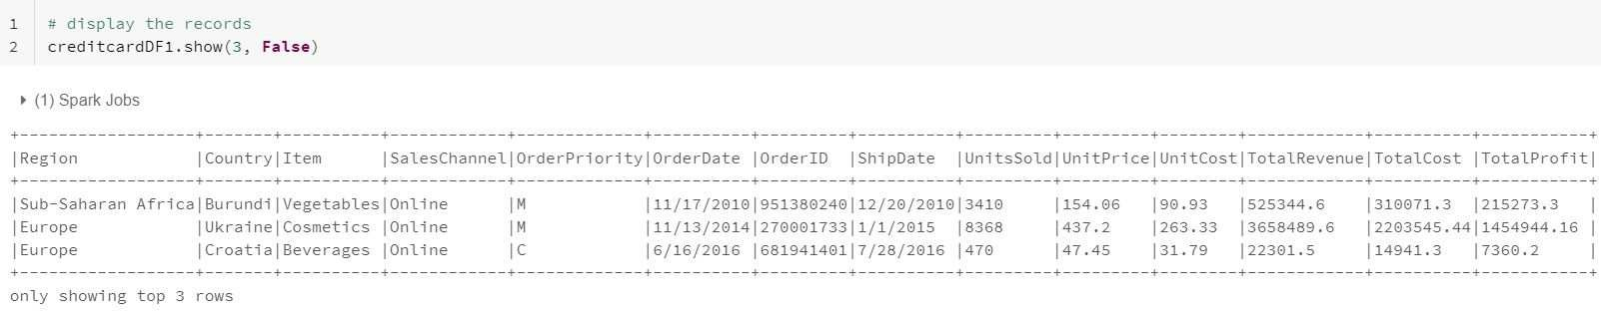
Defining Own Schema
3

Slide 95
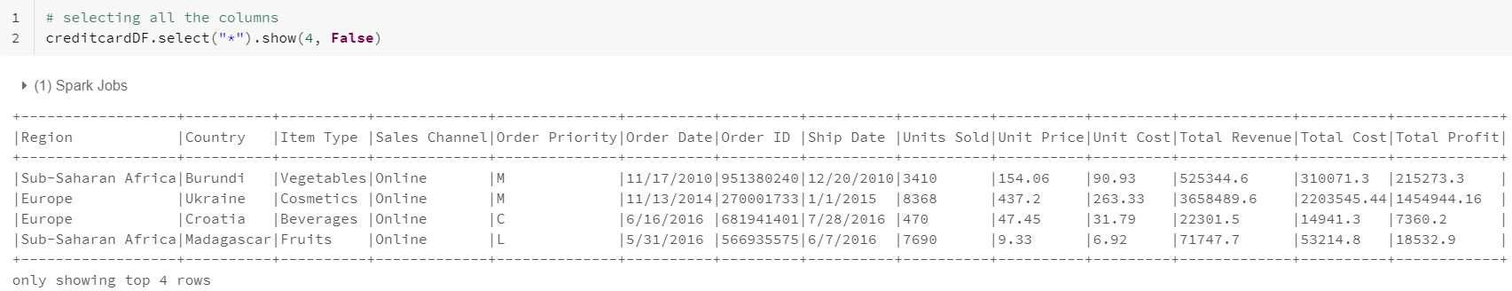
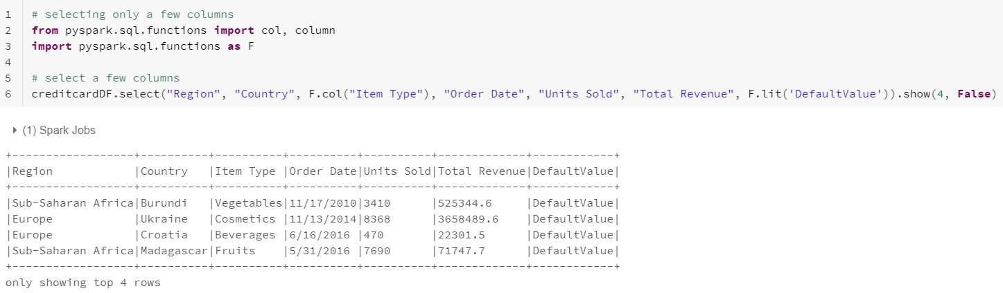
Selecting DataFrame Columns

Slide 96
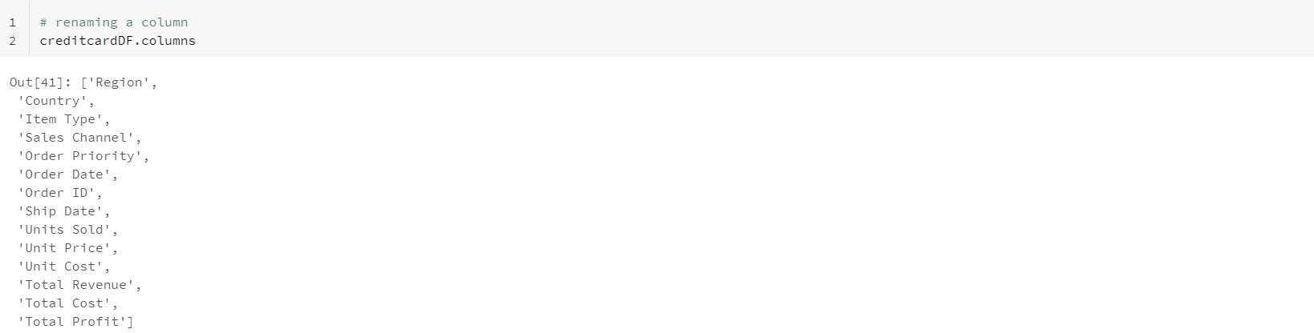
Renaming Columns
1

Slide 97
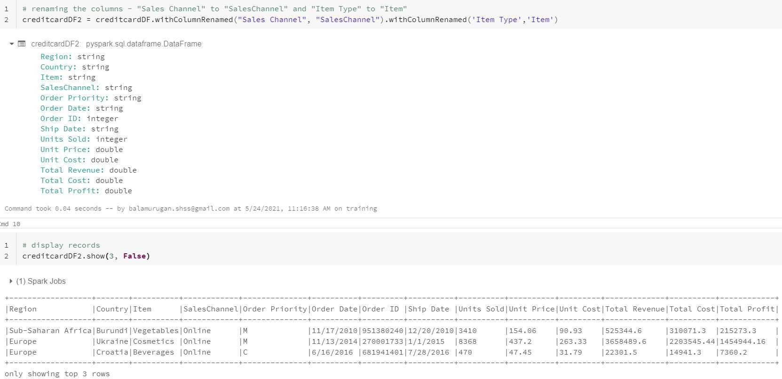
Renaming Columns
2

Slide 98

Changing Columns Data Type

Slide 99

Adding Columns to a DataFrame

Slide 100

Removing Columns from a DataFrame

Slide 101

Arithmetic with DataFrames

Slide 102


How to Filter a DataFrame

Slide 103

Dropping Duplicate Rows
1

Slide 104

Dropping Duplicate Rows
2

Slide 105

Dropping Duplicate Rows
3

Slide 106

selectExpr

Slide 107

Handling null Values
1

Slide 108


Handling null Values
2

Slide 109


Replacing Values

Slide 110
DataFrame Aggregations
1
A set of methods for aggregations on a DataFrame:
agg
avg
count
max
mean
min
pivot
sum

Slide 111

DataFrame Aggregations
2

Slide 112

DataFrame Aggregations
3

Slide 113

DataFrame Aggregations
4

Slide 114


Ordering DataFrame Rows

Slide 115
Cache and Persist
1
Cache() - defaults storage level to MEMORY_ONLY
Persist() - saves the intermediate results in 5 storage levels:
MEMORY_ONLY
MEMORY_AND_DISK
MEMORY_ONLY_SER
MEMORY_AND_DISK_SER
DISK_ONLY

Slide 116

Cache and Persist
2

Slide 117

Cache and Persist
3

Slide 118

Coalesce and Repartition
1
SNo | Coalesce | Repartition
1 | Reduces the number of partitions | Can be used to either increase or decrease the number of partitions
2 | Uses existing partitions to minimize the amount of data shuffling | Creates new partitions and performs full shuffling
3 | Results in partitions having different sizes | Results in partitions having same size of data

Slide 119

Coalesce and Repartition
2

Slide 120


DataFrameWriter
1
%fs executes the list command (“ls”) and displays all the files in the mentioned folder

Slide 121

DataFrameWriter
2

Slide 122
Class Exercise
Class Exercise
Upload a CSV file in to DBFS (“/FileStore/tables/credit.csv”)
Create a DataFrame by reading CSV file using spark.read.format(“csv”)
Apply DSL methods to perform the below:
Select all columns, and select only a few columns
Rename and drop existing columns
Change the data type of a column from float to double
Replace null values
Apply agg functions
Write the result DataFrame in to DBFS (“/FileStore/tables/result/”)

Slide 123
Spark SQL

Slide 124
Table of Content
What is Spark SQL
Creating Temp View Tables from DataFrames
Querying Temp Views
Apply Aggregations using SQL Queries
Ordering the Records using SQLs
SQL Joins
Writing the results in to DBFS
Class Exercise

Slide 125
Spark SQL
Spark SQL is a Spark module for structured data processing
Provides powerful integration with the rest of the Spark ecosystem
Spark SQL brings native support for SQL to Spark
Provides a programming abstraction called DataFrames
Enables working with structured data, either within Spark programs or through JDBC and ODBC connectors

Slide 126

Create Table from a DataFrame
1

Slide 127

Create Table from a DataFrame
2

Slide 128



Querying the Table

Slide 129

Aggregations

Slide 130


Ordering the Records (Asc, Desc)

Slide 131

Joining the Tables
1

Slide 132

Joining the Tables
2

Slide 133

Saving the Results in to DBFS
1

Slide 134


Saving the Results in to DBFS
2

Slide 135
Summary
Apache Spark is a open Source from Apache Software Foundation
It is 100 times faster than Hadoop MapReduce
Resilient Distributed Dataset (RDD) and Direct Acyclic Graph (DAG) are the two important abstractions of Spark
There are two types of RDD Operations: Transformation and Actions
Spark SQL API provides structured data processing

Slide 136
Thank You

